Slide 1

COS1512 – Online Class Session – 07 July 2026
COS1512 – INTRODUCTION TO PROGRAMMING II – Using C++
Academic Year: 2026
Date: 07 JULY 2026
Time: 17:00 PM to 19:00 PM

Slide 2
Topics
Chapter 10
Defining to Classes

Slide 3
Contents
Introduction to Structures
Defining Structures
Accessing Structures
Introduction to Classes

Slide 4
Structures
Structures

Slide 5
Structures vs Arrays vs Enums
struct: A collection of a fixed number of components in which the components are accessed by name. The components may be of different types.
The components of a struct are called the members of the struct.

Slide 6
Structures
A structure (struct) is used to group related variables (often of different types) into a single compound data type.
Consists of a collection of values of different types which are treated as a single item.
A structure can be thought of as an object without any member functions.
It is especially useful for modeling real-world entities.

Slide 7
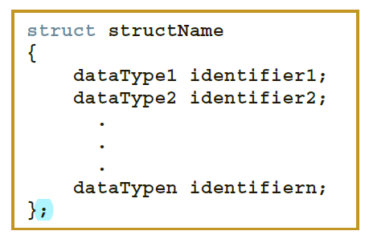
Structure’s General Syntax
The general syntax of a struct in C++ is:

Slide 8
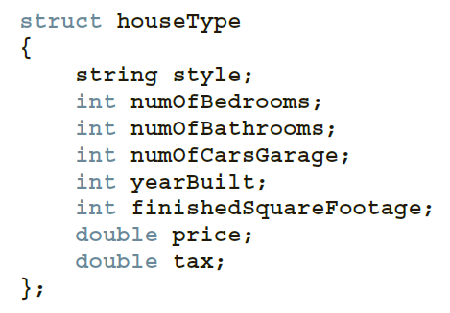
Definition of a Structure
The above statement defines a struct houseType with eight members.
Like any type definition, a struct is a definition, not a declaration. That is, it defines only a data type; no memory is allocated.

Slide 9
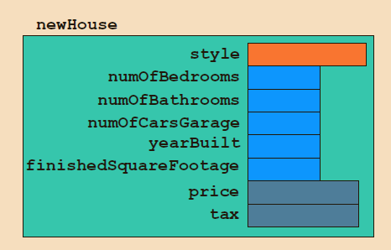
Definition of a Structure
For example, the following statement defines newHouse to be a struct variable of type houseType:
//variable declaration
houseType newHouse;
The memory allocated is large enough to store style, numOfBedrooms, numOfBathrooms, numOfCarsGarage, yearBuilt, finishedSquareFootage, price, and tax

Slide 10
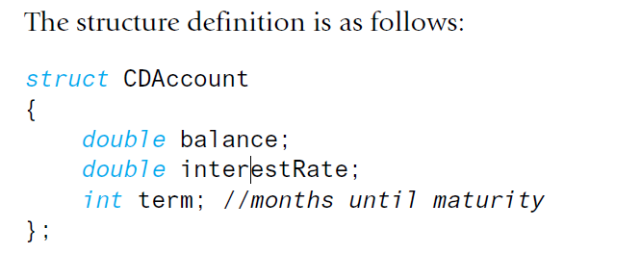
Definition of a Structure
The keyword struct announces that this is a structure type definition.
The identifier CDAccount is the name of the structure type. The name of a structure type is called the structure tag. The tag can be any legal identifier (but not a keyword).
The identifiers declared inside the braces, {}, are called member names.

Slide 11
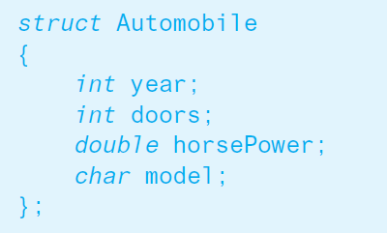
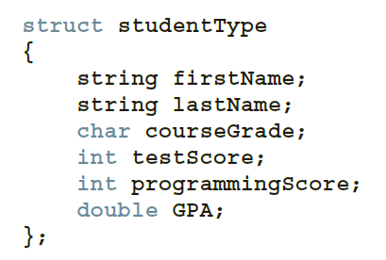
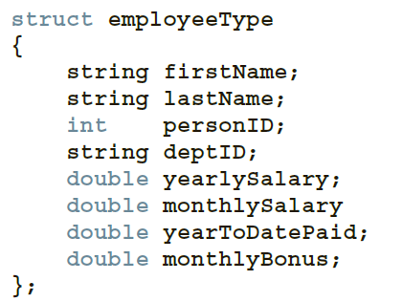
Where to place a structure definition
A structure definition is usually placed outside of any function definition
(in the same way that globally defined constant declarations are placed outside of all function definitions). The structure type is then available to all the code that follows the structure definition.

Slide 12
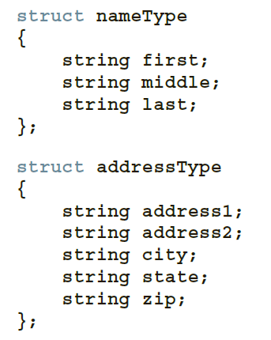
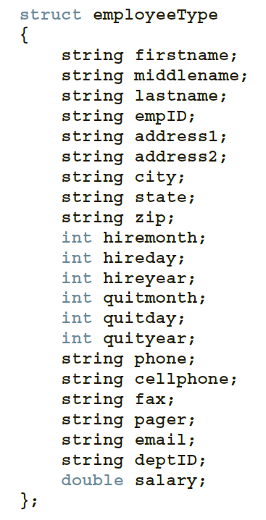
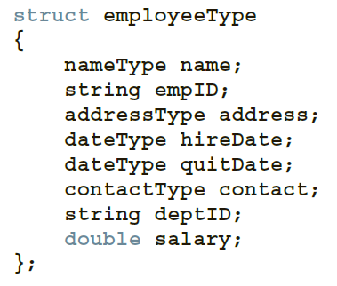
Where to place a structure definition
A structure definition is usually placed

Slide 13
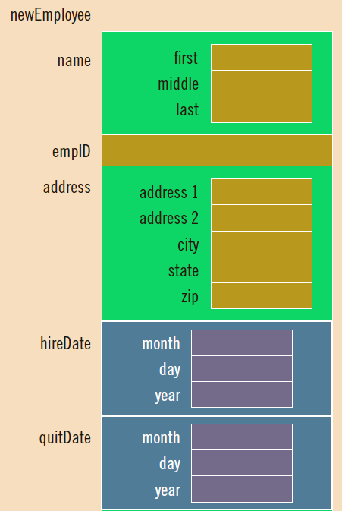
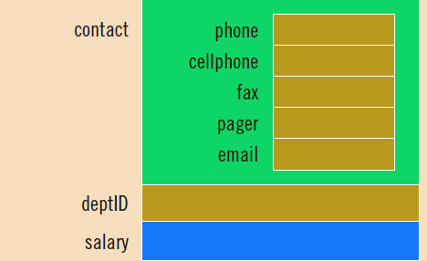
Where to place a structure definition

Slide 14

Accessing struct Members
To access a structure member (component), you use the struct variable name together with the member name; these names are separated by a dot (period).
In C++, the dot (.) is an operator called the member access operator.
The syntax for accessing a struct member is:

Slide 15
Classes and Objects
Class and an Object

Slide 16
Understanding a Class and an Object
An object is a variable that has member functions, and
A class is a data type whose variables are objects.
Thus, the definition of a class should be a data type definition that describes two things:
what kinds of values the variables can hold and
what the member functions are.
We will approach class definitions in two steps (i.e., by defining attributes and behaviours).

Slide 17
Understanding a Class and an Object
A class is a data type whose variables are objects.
The class definition specifies :
(1) what attributes the data type has i.e. the type of values the variables can hold AND
(2) its behaviour (member functions) i.e. what it can do.
When we declare variables of a specific class, we say we instantiate objects of the class. That is, an object is an instance of a class.

Slide 18
Class vs Struct
STRUCT | CLASS
User-defined data type: combines logically related data items of different data types | User-defined data type: set of instructions to build a specific type of object [should be defined as an abstract data type]
Uses keyword struct | Uses keyword class
Defines member variables | Defines member variables and member functions
Syntax: struct struct_name { // struct data members }; | Syntax: class class-name { // data // functions };

Slide 19
Converting a Struct to a Class
// Declaration
class Student
{
public:
Student();
Student(int studID, string n, int y, double ave);
);
void setStudentID(string ID);
void setName(string nam);
void setYear(int yr);
void setAverage(double a);
int getStudentID() const;
string getName() const;
double getAverage() const;
private:
int studentID;
string name;
int year;
double average;
};
Constructor – ALWAYS same name as class.
Mutators
Accessors
Private member variables – cannot be DIRECTLY accessed outside this class

Slide 20
Classes
The keyword class is used to create a class called Student.
The public keyword is an access specifier, which specifies that members (attributes and methods) of the class are accessible from outside the class. You will learn more about access specifiers later.
The variables name, studentID, year and average are declared inside the class.
When variables are declared within a class, they are called attributes.
Note: end the class definition with a semicolon ;.

Slide 21
Constructors
Constructors are special class members which are called by the compiler every time an object of that class is instantiated.
Student studObj1; - default constructor assigns default values.
Student studObj2 = new Student("MyName", 2, 2023, 34.52); - uses parameterized constructor to assign values to the object.

Slide 22
Member Functions
Ideal class definition: you should be able to change the details of
how the class is implemented and the only things you should need to change in any program that uses the class are the definitions of the member functions.
To realize this ideal, you must have member functions so that you
never need to access the member variables directly but access them only through the member functions.
Then, if you change the member variables, you need change only the definitions of the member functions to match your changes to the member variables, and nothing else in your programs need change.

Slide 23
Member Functions
An accessor - public member function in a class that gets (accesses) the value of a private member variable.
A mutator - public member function in a class that sets (mutates) the value of a private member variable.
The default constructor - a constructor that either has no parameters or if it has parameters, all the parameters have default values for their data types.
An overloaded constructor - We can have more than one constructor in a class provided each has a different list of arguments (overloading).
Destructor: function typically used to deallocate memory and do other cleanup functions for a class object and its class members when the object is destroyed. A destructor is called for a class object when that object passes out of scope or is explicitly deleted.

Slide 24
Scope resolution operator ::
The scope resolution operator :: is used with a class name, whereas
the dot operator is used with objects (that is, with class variables).
The scope resolution operator consists of two colons with no space between them.
The class name that precedes the scope resolution operator is called a type qualifier because it specializes (“qualifies”) the function name to one particular type.
For example:
Student :: getName() {
}

Slide 25
Member Functions
Notice that in the function definitions, we use the member names by themselves without giving the object and dot operator.
At this point we are simply defining the member functions.
These definitions will apply to all objects of type Student, but at this
point we do not know the names of the objects of type Student that
we will use, so we cannot give their names.
When the member function is called, for example:
studObj1.getName();
the member name in the function definition is specialized to the name of the calling object.

Slide 26
When to use Structures vs Class
Rule of Thumb
Use struct for plain data structures (like rows in a table).
Use class for objects that encapsulate both data and behaviour.
Use struct when… | Use class when…
You just need to store data | You need behaviour (methods) and abstraction
All members should be public | You want encapsulation (private members)
You want a C-style or plain old data | You’re designing full-featured objects

Slide 27
Object Oriented Programming
Object-oriented programming (OOP) is a computer programming model / framework that organizes software design around data or objects. An object can be defined as a data attribute that has unique attributes and behaviors / methods.
OOP focuses on the objects that developers want to manipulate rather than the logic required to manipulate them.

Slide 28
Basic OOP Concepts
Class
Object
Attributes and methods / functions
Encapsulation
Abstraction
Polymorphism
Inheritance

Slide 29
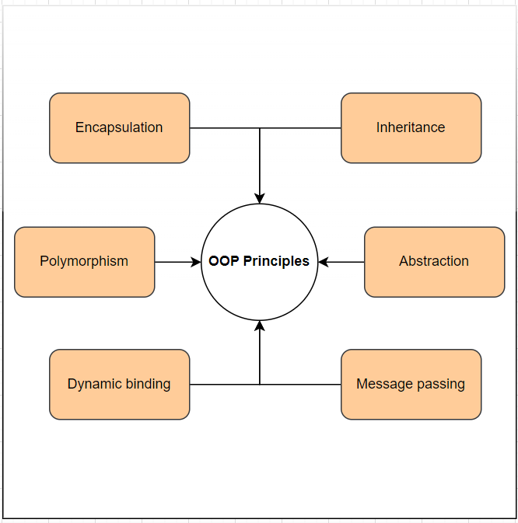
Basic OOP Concepts

Slide 30
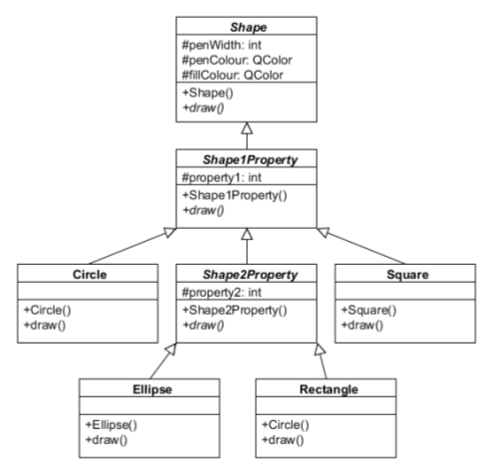
UML Class Diagram

